Slide 1
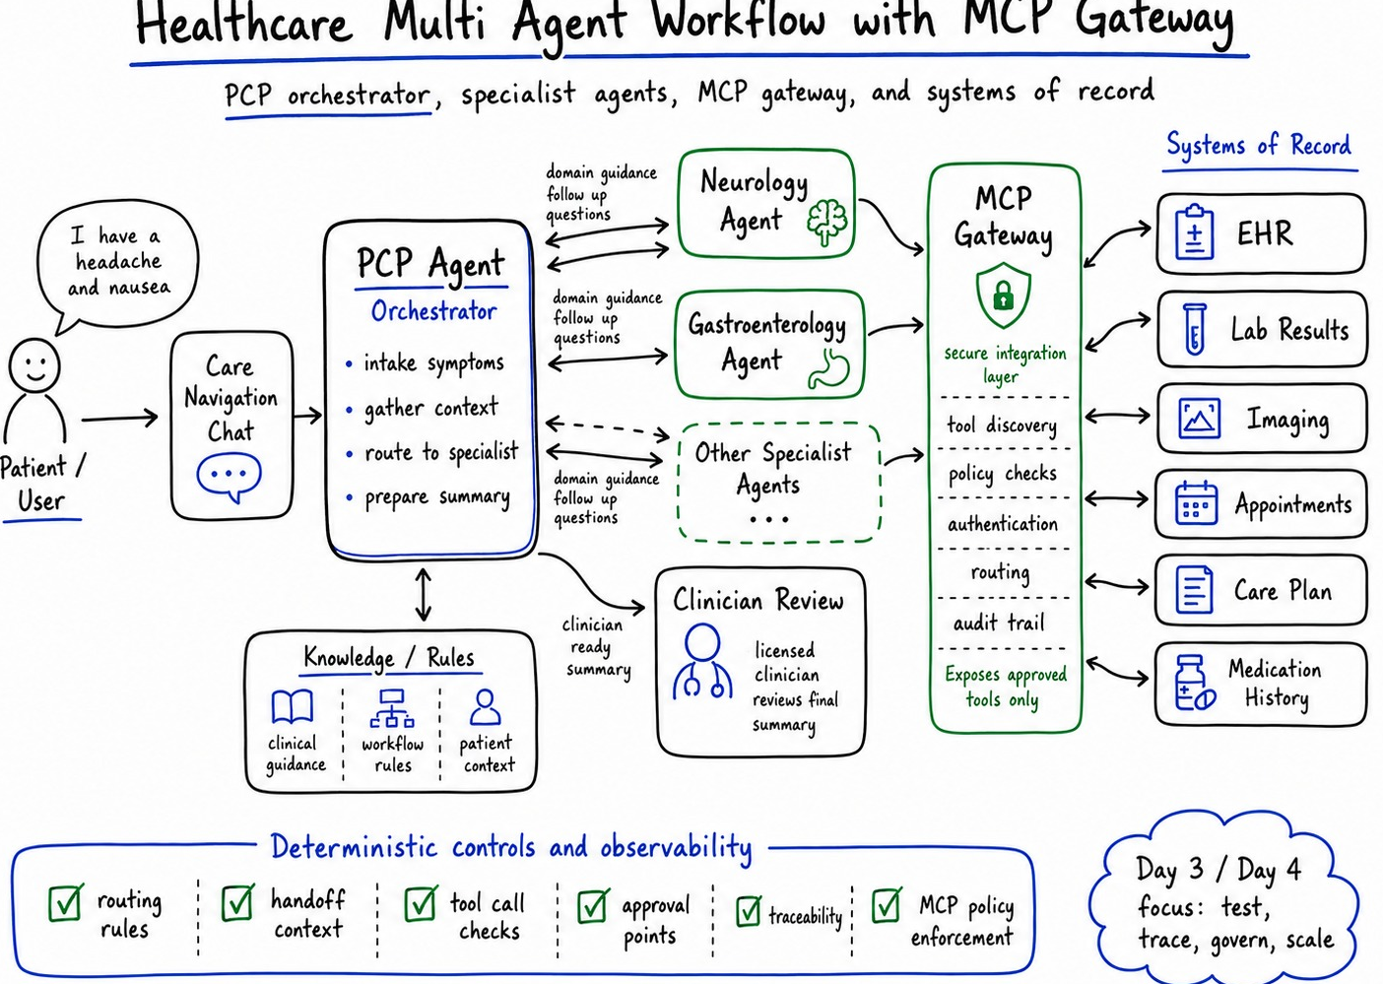
APPLIED AI SUMMIT 2026
When Physicians Cannot
Connect the Dots
Building a Governed Healthcare Agent with IBM Bob
A technical case study on multi-agent orchestration, clinical workflow boundaries, MCP integration, and human oversight.
Monika Aggarwal
Global GTM Leader, Ecosystem Partner Amplification, IBM
Notes:
Open with the personal context. The session is not about replacing physicians. It is about why agentic workflow design matters when patient information is fragmented across encounters, specialists, tests, and follow-ups.

Slide 2
Core thesis
A busy agent can still be wrong. Safe healthcare AI needs workflow, not loose autonomy.
A specialist handoff does not prove the orchestrator understood the context.
The real test is the full path from patient intake to clinician-ready action.
Loose autonomy
Incorrect routing
Weak handoffs
Missed context
Governed workflow
Deterministic checkpoints
Traceable handoffs
Human approval
Operational trust
Testable behavior
Policy-bound tool use
Clinician review
Loose autonomy
Governed workflow
Operational trust
Takeaway
Agent reasoning is useful only inside a designed care-navigation path.
Notes:
Set the frame early. This is the phrase attendees should remember. Activity is not correctness. Routing is not reasoning.

Slide 3
The personal starting point
The patient often becomes the integration layer. Medicine somehow made that sound normal.
Session lens
Start with lived fragmentation. Then show how that became a governed agent design.
Patient reality
Session lens
Multiple specialists see different parts of the case
Symptoms, tests, medications, and follow-ups spread across encounters
The PCP role becomes the coordinator of context
The patient still carries much of the burden
Healthcare lens
The agent must support care navigation. It must not act like an autonomous physician.
Healthcare lens
Enterprise lens
The same failure pattern appears in HR, IT, finance, and other regulated workflows.
Enterprise lens
Notes:
Tell the health story plainly. Avoid too much detail. The point is the friction caused by fragmented context, not the diagnosis.

Slide 4
Why I built this case study
The talk combines patient experience, healthcare delivery, and enterprise AI architecture.
Practitioner credibility
Healthcare delivery
Designed AI-enabled clinical workflow and remote patient monitoring solutions at KP.
Enterprise AI
Builds agentic AI strategies, reusable architectures, and production-focused use cases at IBM.
Eminence
Co-host of Agent Sense and creator of 60 Seconds of Enterprise AI.
Healthcare delivery
Enterprise AI
Eminence
The speaking value is not only the conference logo. It is the fit between topic, healthcare track, real prototype, and production governance story.
Notes:
Use this slide only if you need a brief credibility bridge. It should not sound like a resume. Connect your experience to why this problem is worth discussing.

Slide 5
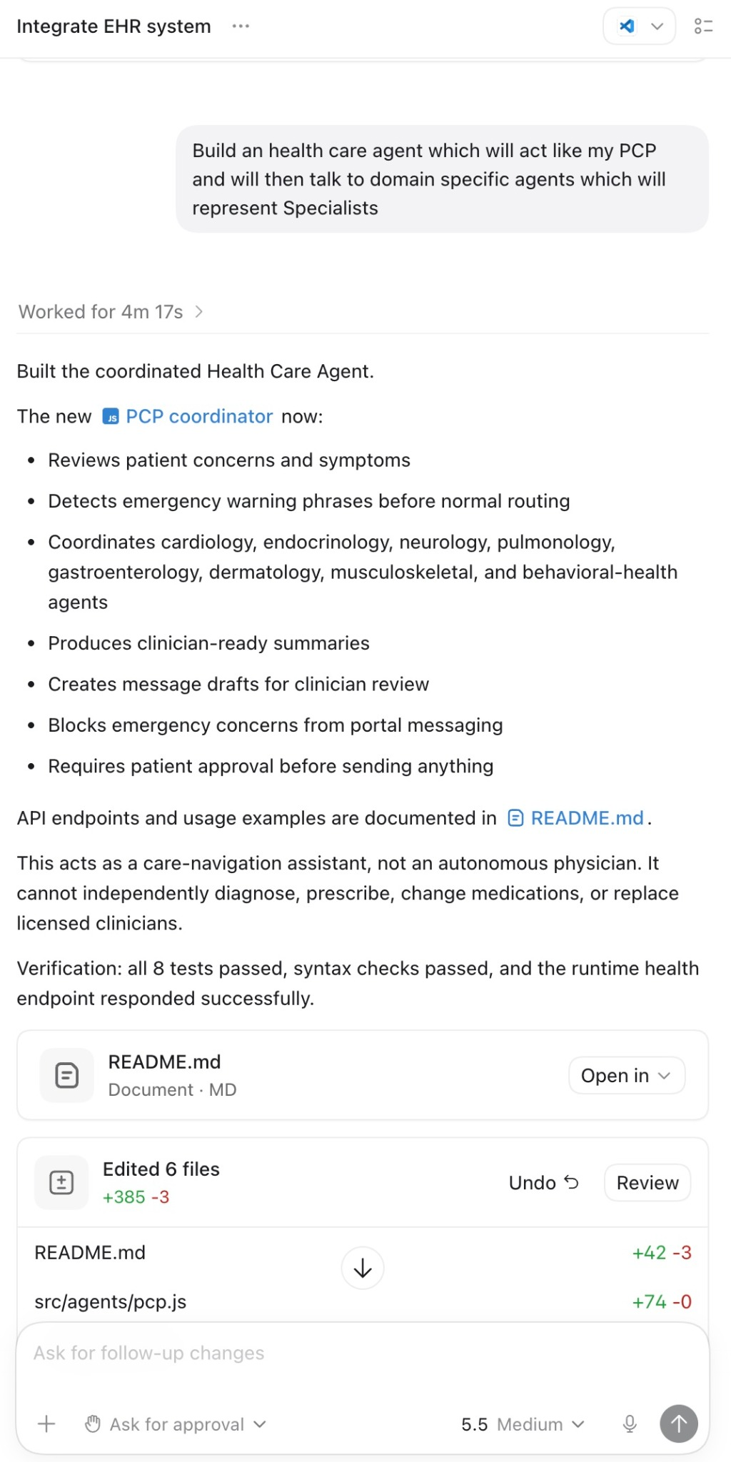
The prototype
A PCP coordinator agent orchestrates specialist support agents.
Built functions
Reviews patient concerns and symptoms
Detects emergency warning phrases before normal routing
Coordinates specialty support agents
Produces clinician-ready summaries
Requires patient approval before sending messages
Boundary
Care-navigation assistant, not autonomous diagnosis, prescription, medication change, or replacement for licensed clinicians.
Boundary
Notes:
Walk through the working prototype. Keep the framing practical. The important design choice is PCP as orchestrator, specialists as bounded support agents, and clinician review as the final safety point.

Slide 6
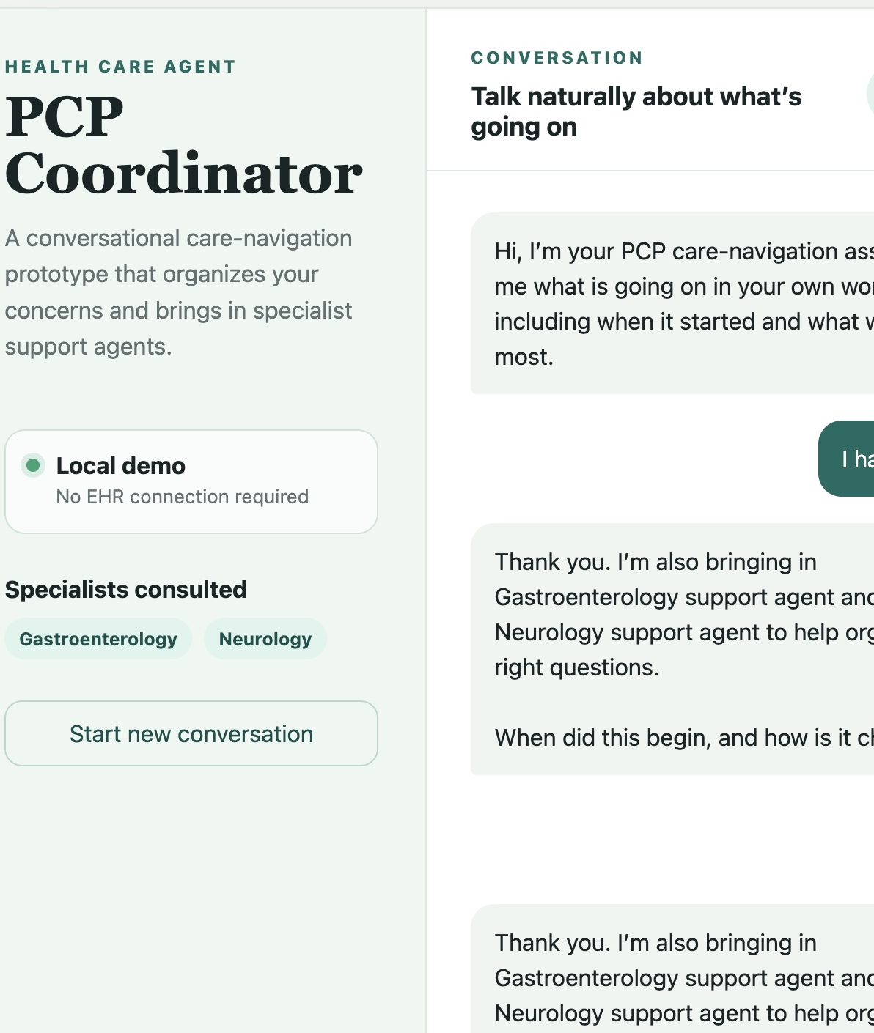
The Day 3 / Day 4 test
The demo worked. The workflow behavior exposed the risk.
Test input
“I have a headache and feel nauseous.”
What happened
The PCP agent repeatedly announced Gastroenterology and Neurology support.
What was missing
Structured intake before routing and clear context transfer.
What happened
What was missing
The safety disclaimer was correct. The workflow behavior was wrong.
Notes:
Use the screenshot to make the problem concrete. Do not over-medicalize the example. The failure is routing before adequate intake.

Slide 7
The gap between routing and reasoning
The agent looked coordinated, but the workflow did not prove understanding.
1. Routing was too loose
Specialists were involved before enough context was gathered.
2. Handoff was not controlled
The workflow did not show what was passed to each domain agent.
3. Next step drifted
The path from intake to follow-up to summary was not deterministic.
1. Routing was too loose
2. Handoff was not controlled
3. Next step drifted
What should have happened first
Design lesson
When did symptoms begin?
How severe are they?
What changed?
What warning signs need escalation?
What context is required before routing?
Observability tells us what happened. Governance must define what should happen.
Notes:
This is the central critique. It is also where your broader enterprise point becomes clear. Loose routing is not a healthcare-only issue.

Slide 8
Reference architecture
PCP orchestrator, bounded specialist agents, MCP gateway, systems of record, and clinician review.
Neurology
Agent
Systems of record
EHR
Labs
Imaging
Care Plan
PCP Agent
Orchestrator
Intake
Context
Routing
Summary
MCP
Gateway
Auth
Policy
Routing
Audit
Patient
concern
Care Navigation
Chat
GI
Agent
Clinician
Review
Other
Specialists
Approved tools only. Human review before high-impact action.
Notes:
This is the clean architecture slide. Explain MCP as the controlled integration layer. Avoid deep protocol detail unless asked.

Slide 9
Why MCP belongs in the story
MCP turns tool access into an explicit contract that can be reviewed, authorized, logged, and limited.
Agent power increases risk unless access is constrained.
Expose
Approved tools and resources only
Authorize
Consent, identity, scopes, and role controls
Observe
Tool calls, parameters, responses, and failures
Block
Unsafe or out-of-scope actions
Expose
Authorize
Observe
Block
In healthcare, the gateway is not decoration. It is where policy becomes runtime behavior.
Public MCP references: modelcontextprotocol.io/specification and modelcontextprotocol.info/specification
Notes:
Tie MCP to business risk. The audience does not need a protocol tutorial. They need to understand why tool access, consent, and audit trails must be part of the architecture.

Slide 10
Control points that make the workflow testable
Define where the agent may reason and where the workflow must follow fixed rules.
1
2
3
4
5
Required intake
symptom onset, severity, change, warning signs
Routing rules
specialist only after required context
Handoff context
what moved, why, and to whom
Tool checks
right tool, fields, permissions
Clinician approval
review before high-impact action
Required intake
Routing rules
Handoff context
Tool checks
Clinician approval
Regression suite
Every prompt, model, policy, tool, and agent change can alter behavior
Test the trajectory, not only the final answer
Capture traces for failures, latency, cost, drift, and user feedback
Notes:
This slide converts your blog principles into an operating model. It should feel practical enough for an architecture team to use the next day.

Slide 11
Suggested live demo arc
Show the audience the difference between a demo that responds and a workflow that behaves correctly.
Act 1: Base prototype
Show natural-language intake and PCP orchestration.
Act 2: Failure test
Run “headache and nausea” and show loose routing.
Act 3: Controlled design
Add required intake and routing boundaries.
Act 1: Base prototype
Act 2: Failure test
Act 3: Controlled design
What to narrate
“The agent is active. That is not the same as being correct.”
What to show
Trace: intake fields, routing decision, handoff context, tool call, approval.
What to avoid
Do not let the demo imply diagnosis, treatment, or autonomous clinical action.
What to narrate
What to show
What to avoid
Notes:
This gives you a crisp recording plan. Keep the demo bounded. The strongest moment is showing the failure and then showing the design fix.

Slide 12
From prototype to production readiness
Day 3 and Day 4 work is where agentic AI earns trust. Yes, the boring part saves the patient.
Demo works
Agents answer and tools connect. Useful, but not enough.
Workflow is testable
Expected paths and control points are defined.
Workflow is governable
Policy, access, approval, and traceability are built in.
Workflow improves
Monitoring and regression tests run after change.
Demo works
Workflow is testable
Workflow is governable
Workflow improves
Production readiness means teams can prove the workflow behaved safely, not merely that the model produced a plausible response.
Session promise
Move from “look, an agent answered” to “we can prove the workflow behaved safely.”
Notes:
Use this to connect your case study to executives and architects. Production readiness means testability, governance, and improvement loops.

Slide 13
What attendees should take away
A reusable pattern for healthcare agents and other high-impact enterprise workflows.
One key takeaway
A healthcare agent becomes useful when it connects fragmented patient information into a longitudinal view, identifies what needs attention, and supports the right next action with clear human oversight.
Design
Start with the process and expected clinical workflow outcome.
Govern
Define boundaries, approvals, routing rules, and tool access.
Test
Validate the full path from intake to action after every change.
Design
Govern
Test
Notes:
This matches your follow-up answer to the summit. Keep it simple. This is the headline for the moderator and audience.

Slide 14
Seeded questions for Q&A
Prepared questions that help steer the conversation when the audience goes quiet. The human condition, apparently.
What problem were you trying to solve with the healthcare agent?
Why is longitudinal patient context so difficult to assemble in practice?
How did you structure the agent workflow in IBM Bob?
What role does human oversight play in the workflow?
How do you prevent an agent from taking actions beyond its intended scope?
What surprised you most when you moved from concept to prototype?
What would need to change before a solution like this could be used in a real clinical environment?
Notes:
These are seeded moderator questions. Provide them to the event team if requested.

Slide 15
Evidence and source inputs
Working sources used to shape this draft.
Session inputs
Accepted title and email details: Day 2 Healthcare AI, October 14, 3:35-4:05 ET, Stage ONE
Uploaded blog: Day 3 & Day 4 Operational Challenges for Multiagent Workflows
Prototype screenshots: PCP Coordinator, IBM Bob build result, MCP architecture sketch
Public research inputs
Applied AI Summit 2026 public page and schedule: appliedaisummit.org
John Snow Labs Applied Healthcare AI Summit 2026 program history and healthcare AI focus
Model Context Protocol specification: tools, resources, prompts, sampling, elicitation, consent, and authorization guidance
MAST framing for multi-agent failure modes: specification, system design, inter-agent misalignment, task verification, and termination
Replace or delete this appendix before final delivery if the event deck should stay clean.
Notes:
Keep this as a working appendix. It helps you remember how the deck was built.

